Slide 1
TABASCO TAsk BASed COnfiguration Management Concepts possibly interesting for ASML
Uwe Satthoff
2019-12-xx

Slide 2
TABASCO – concepts which might be interesting for ASML
Object Oriented interface (layer) implementing:
Automatic cashing
Interface layer on top of CtCmd
CtCmd used as object of class ClearCase::Common::cleartool
keeping a cleartool process in memory, which
speeds up execution of cleartool commands
Common cleartool interface for all scripts
Presuppossed only Perl coming with ClearCase is used in scripts
No dependency anymore of cadappl
No dependency of ClearCase 32-bit or 64-bit

Slide 3
TABASCO – concept of tasks, releases
on top of
CC meta data
CC paths
Fully labeled CC paths configuration

Slide 4
TABASCO – one to many task trees

Slide 5
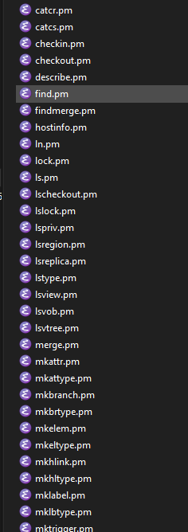
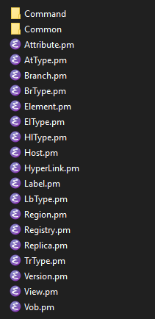
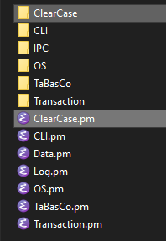
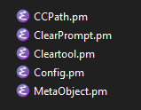

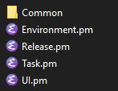
TABASCO – perl implementation with Perl of CC
use only Perl in CC install
CtCmd in CC install
Base classes
Interfaces
cleartool command calls e.g.: ClearCase::describe( argv => $task->getName(), short => 1 );
Interface classes
Interface commands

